Slide 1
UX - QHO428

Slide 2
UX
QHO428
Navigation Structure / The Structure Plane
Week 5

Slide 3
Module Learning outcomes
On successful completion of this module, you will be able to
Identify the key component of User Experience context, including understanding the technology and stakeholders.
Interpret digital product or service requirements including business, technical and potential user sources and define appropriate measures of success, including goals, objectives and key performance indicators (KPIs).
Explain issues with usability and effectiveness of digital products and services and to identify areas for improvement.
Describe digital product usability, accessibility and other legal requirements.
Interpret user types and their goals, behaviours and pain points using appropriate design artefacts to inform the design process.

Slide 4
Assessment
Assignment : 100% - Individual written report

Slide 5
Week 5 - Objectives
Navigation Structure / Structure plane
Conceptual Models
Information architecture
Workflow Diagrams
Notes:
In today's lecture, you will be learning the following objectives:
Navigation Structure / Structure plane
Conceptual Models
Information architecture
Workflow Diagrams
In seminar 5 we will be discussing the topics that we have covered during the lecture today.
We will discuss practically the Navigation Structure / The Structure Plane.
To prepare for next week you could further research the use of different navigation structure for a different purpose

Slide 6
Navigation structure
A navigation structure is key to planning a website.
It involves a bit higher level of abstraction than just sketching pages.
A navigation flowchart (or sitemap) organizes how you are going to guide visitors through your material.

Slide 7
The Structure Plane
The structure plane defines the way in which features fit together
  It is a shift from the more abstract information gathering phases
  Moving towards concrete functionality
Also known as interaction design and information architecture
  We consider the organisation, grouping and categorising of content
  Aiming to define patterns and sequences to presented to users
    It deals with the way we convey information to users

Slide 8
Navigation
Navigation Patterns are established Information architecture (IA ) concepts
  These patterns allow us to effectively categorise user interaction
  Following established mental models for behaviour
These include:
  Hierarchy
  Database
  Hypertext
  Linear
  Combined
  Catalogue
  Hub & Spoke

Slide 9
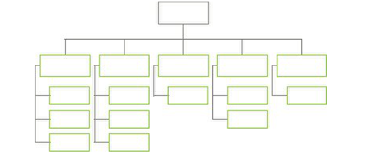
Hierarchical navigation
Hierarchies can be broad or deep
  Broad hierarchies have lots of top level items but few levels
  Deep hierarchies have fewer top level but more sub levels
A hierarchy can also be described as strict or polyhierarchy:
  In a strict hierarchy an item can be in one and only one place.
  In a polyhierarchy an item can be in more than one place.

Slide 10
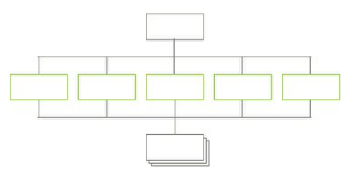
Database
The database pattern is used for content with consistent structure
  The individual content usually have no connection to each other
The database pattern uses consistent fields and metadata
  Creating a page on an identical template

Slide 11
Usability Guideline on Navigation
To relieve memory overload and avoid getting lost, web usability studies suggest several guidelines:
  visualizing the structure of information space;
  providing easy and flexible access to the navigational information;
  providing context cues and navigation trace or history;
  behaving consistently;
  keeping the navigation system itself simple but meaningful.
Based on the first two features, a 2 dimensional mapping framework is developed to categorize and assess major navigation systems.

Slide 12
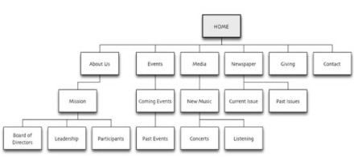
Graphical site maps/flowcharts
Graphical site maps/flowcharts help designers step back, visualize a user’s experience with the site, and adjust the navigation flow as appropriate.
Based on a sketched-out concept for navigation, you (or a designer you work with) can design pages that implement that navigation structure, like the artwork in the following figure

Slide 13
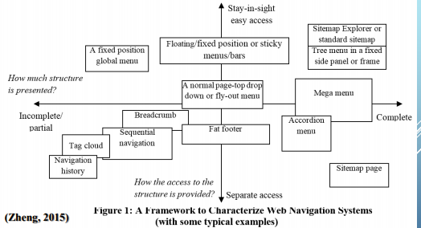
A Framework to Characterize Web Navigation Systems
(with some typical examples)

Slide 14
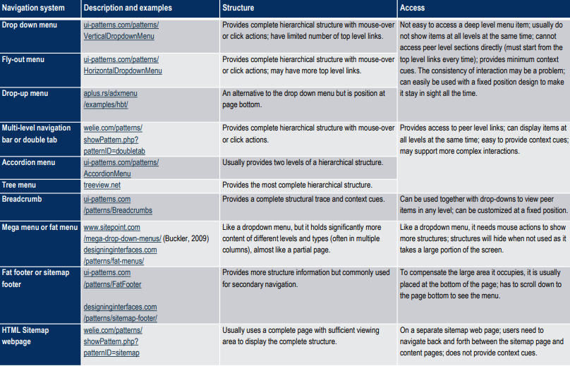
Common Navigation Designs

Slide 15
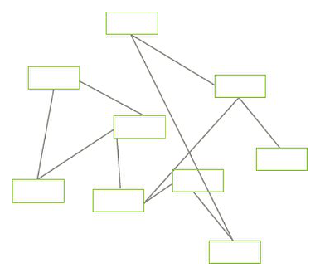
Hypertext
Hypertext pattern is ‘interesting’ some would categorise it as an anti-pattern
Wiki’s are one of the best examples of the hyperlink pattern
  Each page is linked through associative links
  Little or no top level navigation
Notes:
Hypertext structures are particularly useful when the content is being developed over a period of time and you don’t know exactly what you are going to create.
In this situation it would be practically impossible to identify a detailed structure up front, or even to identify a basic pattern for a site.
A lot of documentation projects start like this – people write individual pages of documentation as they get around to them and make relationships between them with links.
Many sites that start with a hypertext structure are later re-organised, when the content is known

Slide 16

Linear
Linear navigation structures follow a straight line
  Rare in the web – checkout tasks are the most common
Linear navigation refers to a navigation system where the web pages are accessed in a sequential manner.
"A linear structure is suitable for a site that contains information that is best viewed like a book, one page after another.
An example might be a site that contains a PowerPoint presentation

Slide 17
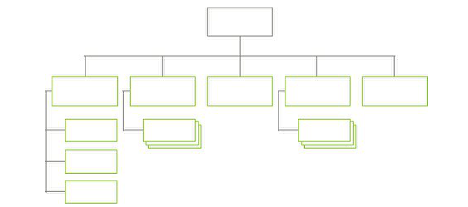
Combined Pattern
Most websites are a combination of multiple techniques
  Hierarchy & Database combined form the majority of websites
The challenge with this pattern is deciding what will be structured and what is data driven

Slide 18
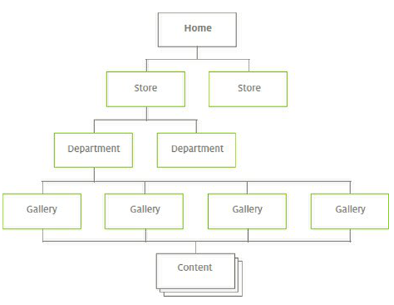
Catalogue
The catalogue pattern is a variant of the database pattern
  Particularly common in e-commerce.
    At the bottom level is the content
    Above that are up to three levels of hierarchy
    Depending on the size of the site and type of content

Slide 19
Jarred Spool examined this pattern and categorised that most pages were:
Gallery pages: these provide direct access to the content pages.
Department pages: provide access to the galleries.
Store pages: provide access to the department pages.

Slide 20
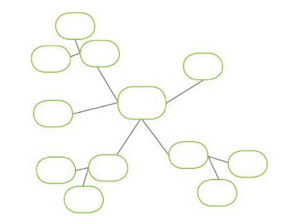
Hub & Spoke
Hub and spoke is an alternative hierarchical pattern
  Its difference comes from user usage
With a hierarchy, people tend to start at a point in it
  Then move down into deeper and deeper content
  Often sticking within the one branch of the hierarchy.
With a hub and spoke, people move down one level
  Then return to the starting point (the hub)

Slide 21
How to build an Information Architecture
Decide what we are creating
  Top level? Hierarchical?
  If a database come up with the meta tags
Just do it!
  Build it, if you are unsure try different patterns
  Test with the user!
Check it
  Verify your models with users, check against personas
  With databases check the attributes and constraints
Revise
  Go back to step 2!
Stop
  Stop going back to step 2!
Discuss

Slide 22
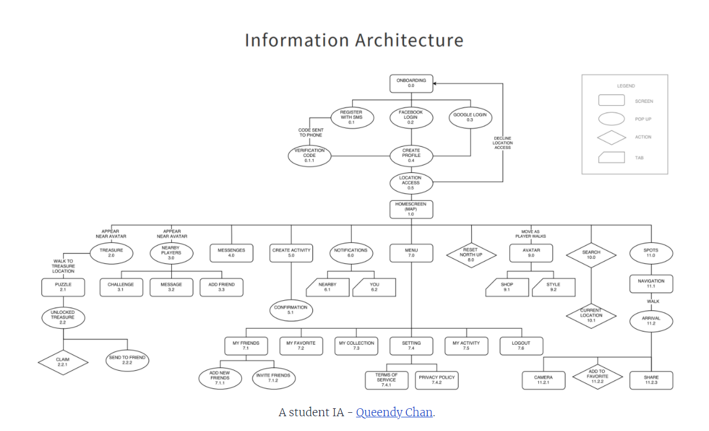

Slide 23
This model isn’t perfect, but it organizes app hierarchy clearly and delineates what the user either sees or does at any given point.
Follow: Queendy Chan
Product Designer

Slide 24
The Best Information Architecture Tools
There are plenty of software applications that allow for building an IA, but few are simple and quick enough to make the experience enjoyable. Or at the very least, easy to manage.
Draw.io, is completely free for personal and professional use and automatically plugs into Google Drive. It also has integrations with Confluence and JIRA, which are paid. Draw.io is excellent for flowcharting, creating user flows and information architecture, and with Drive functionality, multiple people can work on the same document and see changes live. There’s also a free offline version.
Lucidchart is another great tool that provides a slightly better experience than Draw.io and has additional benefits like pre-built templates, many more integrations, a mobile app (rated at 2.5 stars on the App Store), and support for enterprise.

Slide 25
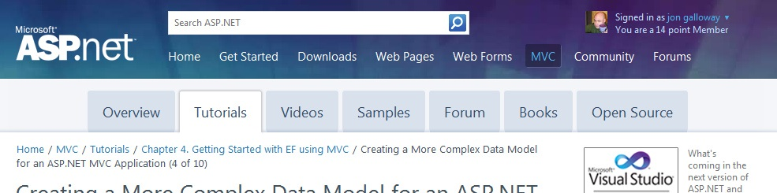
“Breadcrumbs”

Slide 26
What
On each page in a deep navigational hierarchy, show a list of all the parent pages up to the main or home page
Use when
Your application or site has a hierarchical structure with two or more levels.
Why
Breadcrumbs show each level or hierarchy leading to the current page from the top of the application all the way down. In a sense they show a single linear “slice” of the overall map of the site or app.
Breadcrumbs are usually clickable links that allow the user to use them as a navigational device.
How
Near the top of the page, put a line of text or icons indicating the current level of hierarchy. Start with the top level, and place the nest level to it’s right, continuing on until the current level. Between the levels put a graphic or text character to indicate the parent/child relationship. This is usually an angle bracket, but can be a slash, or any other symbol.
Examples
The Windows 7 control panel

Slide 27
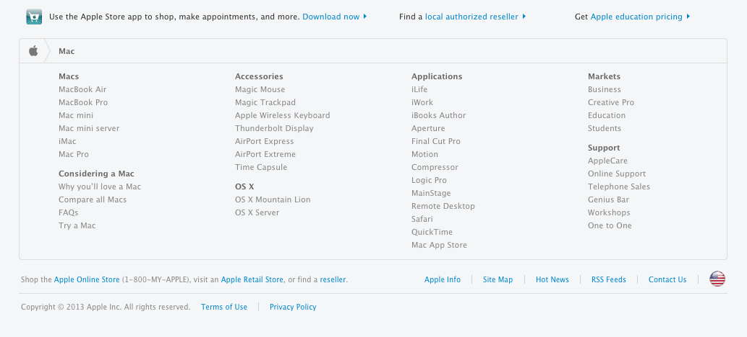
“Sitemap Footer”
Notes:
What
Place a site map into the footer of every page in a site. Treat it as part of the global navigation, complementary to the header. Abridge the site map if you need to make it fit into a compact space.
Use when
The site you’re designing uses a generous amount of space on each page, and you don’t have severe constraints on page size or download time. You don’t want to take up too much header or sidebar space with navigation.
The site has more than a handful of pages, but not an outrageously large number of categories and “important” pages (things that users will look for). You can fit a reasonably complete site map, at least for pages that aren’t in the header, into a strip no taller than about half of a browser window.
There may be a global navigation menu in the page header, but it doesn’t show all levels in the site hierarchy; maybe it only shows the top-level categories. You prefer a simple, well-laid-out footer instead of ”Fat Menus”, perhaps because of implementation ease or accessibility issues.
Why
Sitemap Footers make a complex site more discoverable. They expose many more navigation options to visitors than they might otherwise have.
By showing so many links on every page, you make it possible for a user to jump directly from any subpage to any other subpage (or major page, anyhow). You thus turn a multi- level site where subpages aren’t linked to the subpages in other site sections, into a fully connected site. The footer is where the user’s attention lands when she reads to the end of a page. By placing interesting links there, you entice the user to stay on the site and read more.
Finally, showing users the whole site map gives them a strong sense of how the site is constructed and where they might find relevant features. In complex sites, that could be valuable.
You may find yourself trying to choose between a Sitemap Footer design and a ”Fat Menus” design. In conventional websites, a Sitemap Footer would be easier to implement and debug because it doesn’t depend on anything dynamic: instead of showing fly-out menus when the user rolls over items or clicks on them, a Sitemap Footer is just a set of static links. It’s also easier to use with screen readers and it doesn’t require fine pointer control, so it wins on accessibility as well.
On the other hand, the footer may be ignored by busy or casual users who focus only on the page content and the headers. Usability-test if you have any doubts, and watch the click metrics to see if anyone even uses the Sitemap Footer.
How
Design a page-wide footer that contains the site’s major sections (categories) and their most important subpages. Include utility navigation, tools such as language choice or Social Links, and other typical footer information such as copyright and privacy statements.
This might constitute a complete site map for your site, or it might not. The idea is to cover most of what visitors need to find, without overloading the header or sidebar navigation. In practice, what often happens is that the global navigation options at the top of the page reflect a more task-oriented design—it tries to answer visitors’ immediate questions regarding “What is this about?” and “Where do I find X right this second?” Meanwhile, the Sitemap Footer shows the actual hierarchical structure of the site itself. This two-part arrangement appears to work well.
If your site deals with content that itself requires complex navigation—such as a large set of products, news articles, music, videos, books, and so on—you could use the top of the page for content navigation and the Sitemap Footer for almost everything else.

Slide 28
Here are some features that can often be found in Sitemap Footers:
Major content categories
Information about the site or organization
Partner or sister sites—for example, sites or brands owned by the same company
Community links, such as forums
Help and support
Contact information
Current promotions
Donation or volunteer information, for non-profits
Examples
The Apple Store website
Microsoft
Weebly.com

Slide 29
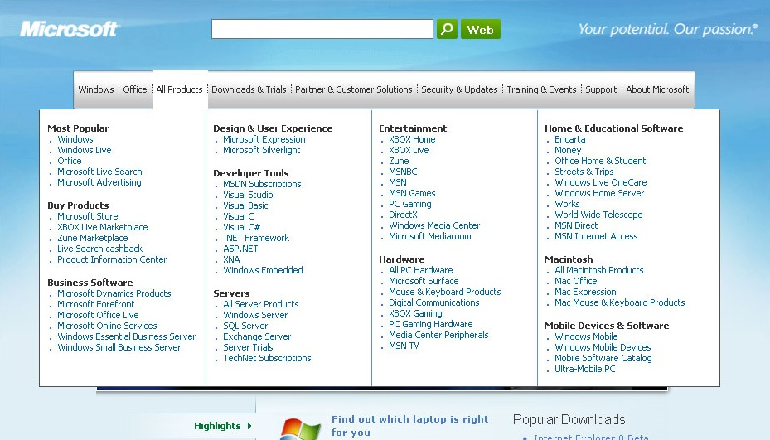
“Fat Menus”
Notes:
What
Display a long list of navigation options in drop-down or fly-out menus. Use these to show all the subpages in site sections. Organize them with care, using well-chosen categories or a natural sorting order, and spread them out horizontally.
Use when
The site or app has many pages in many categories, possibly in a hierarchy with three or more levels. You want to expose most of these pages to people casually exploring the site, so they can see what’s available. Your users are comfortable with drop-down menus (click to see them) or fly-outs (roll over them with the pointer).
Why
Fat Menus make a complex site more discoverable. They expose many more navigation options to visitors than they might otherwise find.
By showing so many links on every page, you make it possible for a user to jump directly from any subpage to any other subpage (for most subpages, anyhow). You thus turn a multi-level site (where subpages aren’t linked to the subpages in other site sections) into a fully connected site.
Fat Menus are a form of progressive disclosure, an important concept in user interface design. Complexity is hidden until the user asks to see it. A visitor to a site that uses these can look over the menu headings to get a high-level idea of what’s there, and when he’s ready to dive in, he can open up a Fat Menu with a gesture. He isn’t shown millions of subpages before he’s ready to deal with them.
If you’re already using menus in your global navigation, you might consider expanding them to Fat Menus if surfacing more links makes the content more attractive to casual browsers. People won’t have to drill down into categories and subcategories of your site hierarchy in order to discover interesting pages; they’ll see them there, right up front.
How
On each menu, present a well-organized list of links. Arrange them into Titled Sections if they fit into subcategories; if not, use a sorting order that suits the nature of the content, such as an alphabetical or time-based list.
Use headers, dividers, generous whitespace, modest graphic elements, and whatever else you need to visually organize those links. And take advantage of horizontal space—you can spread the menu across the entire page if you wish. Many sites make excellent use of multiple columns to present categories. If you make the menu too tall, it might go right off the end of the browser page. (The user controls how tall the browser is; guess conservatively.)
The best sites have Fat Menus that work stylistically with the rest of the site. Design them to fit well into the colour scheme, grid, and so on of the page.
Some menu implementations don’t work well with accessibility technology such as screen readers. Ensure that your Fat Menus can work with these. If they can’t, consider switching to a more static strategy, such as a Sitemap Footer.
Examples
Microsoft.com
Slate.com
British Red Cross
Nike.com

Slide 30
Combined Pattern
Most websites are a combination of multiple techniques
  Hierarchy & Database combined form the majority of websites
The challenge with this pattern is deciding what will be structured and what is data driven

Slide 31
Catalogue
The catalogue pattern is a variant of the database pattern
  Particularly common in e-commerce.
    At the bottom level is the content
    Above that are up to three levels of hierarchy
    Depending on the size of the site and type of content
Notes:
Jared Spool is an American writer, researcher, speaker, educator, and an expert on the subjects of usability, software, design, and research. He is the founding principal of User Interface Engineering (UIE), a research, training, and consulting firm that specializes in website and product usability.
Jarred Spool examined this pattern and categorised that most pages were:
Gallery pages: these provide direct access to the content pages.
Department pages: provide access to the galleries.
Store pages: provide access to the department pages.

Slide 32
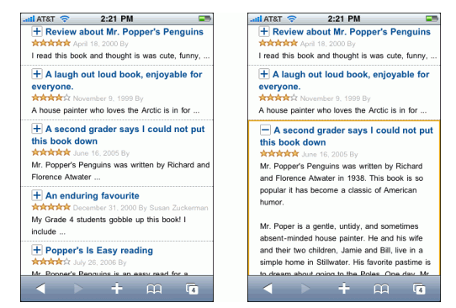
“List Inlay”
List Inlay shows an item's details within the context of the list itself. The user can see the surrounding items, which might help in understanding and using the item contents. Also, a user can see the details of multiple items at once.
Notes:
What
Show a list of items as rows in a column. When the user selects an item, open that item’s details in place, within the list itself. Allow items to be opened and closed independently of each other.
Use when
You have a list of items to show. Each item has interesting content associated with it, such as the text of an email message, a long article, a full-size image, or details about a file’s size or date. The item details don’t take up a large amount of space, but they’re not so small that you can fit them all in the list itself.
You want the user to see the overall structure of the list and keep that list in view all the time, but you also want her to browse through the items easily and quickly. Users may want to see two or more item contents at a time, for comparison.
The list of items has a vertically oriented, columnar structure.
Why
A List Inlay shows an item’s details within the context of the list itself. The user can see the surrounding items, which might help in understanding and using the item contents.
Also, a user can see the details of multiple items at once. This is not possible in most other ways of displaying item details. If your use cases call for frequent comparison of two or more items, this might be the best option.
How
Show list items in a column. When the user clicks on one, open the item in place to show the details of that item. A similar gesture should close the item back up again.
When an item is opened, enlarge the item’s space downward, pushing the subsequent items down the page. Other items do the same when opened. A scrolled area should be used to contain this ever-changing vertical structure, since it could get very tall indeed!
To close the details panel, use a control that clearly indicates its purpose (e.g., “Close” or “X”). Some implementations of List Inlay only put that control at the end of the details panel, but users may need it at the top if the panel is long and they don’t want to move down the whole thing. Put a closing control very near the original “open” control (or replace one with the other). This at least ensures that the user’s pointer won’t move very far if she wants to open an item, glance at it, close it, and move on.
Use an Animated Transition as the item opens and closes, to keep the user oriented and to focus attention on the newly opened item.
If your application permits the user to edit items, you could use a List Inlay to open an editor instead of item details (or in addition to them).
A list that uses List Inlays works the same way as an Accordion: everything lies in a single column, with panels opening and closing in situ within it.
Examples
Google Reader uses a List Inlay within the context of a Two-Panel Selector. It has a multi-level hierarchy of containers to present; the containers are shown in the tree selector on the left, but the list of articles takes up Centre Stage and the user can then open them in place to read them.

Slide 33
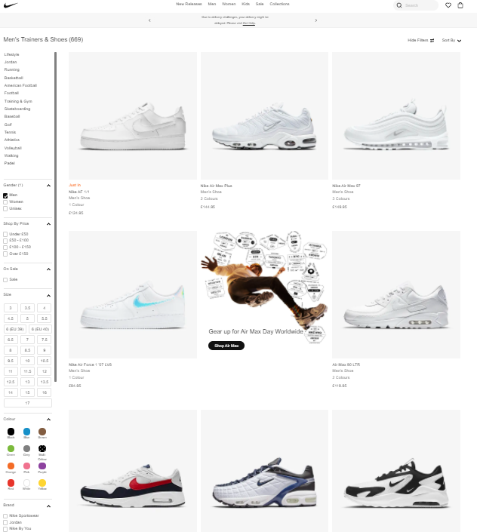
“Grid of Equals”
A grid that gives each item equal space announces that they have equal importance. The common template for items within the grid tells the user that the items are similar to each other.
Notes:
What
Arrange content items in a grid or matrix. Each item should follow a common template, and each item’s visual weight should be similar. Link to jump pages as necessary.
Use when
The page contains many content items that have similar style and importance, such as news articles, blog posts, products, or subject areas. You want to present the viewer with rich opportunities to preview and select these items.
Why
A grid that gives each item equal space announces that they have equal importance. The common template for items within the grid tells the user that the items are similar to each other. Together, these techniques establish a powerful visual hierarchy that should match the semantics of your content.
Grids look neat, ordered, and calming. That may suit the style of your site or app.
How
Figure out how to lay out each item in the grid. Do they have thumbnail images or graphics? Headlines, subheads, summary text? Links to jump pages (e.g., a page with the full story)? Render them with more than just blocks of body text: make headlines of different colours, be creative with whitespace, and use images if you can do so evenly across all items. Experiment with ways to fit all the right information into a relatively small space— tall, wide, or square—and apply that template to the items you need to display.
Now arrange the items in a grid. You could use a single row, or a matrix that’s two, three, or more items wide. Consider page width as you do this design work—what will your design look like in a narrow window? Will most of your users have large browser windows? What happens on tiny mobile devices?
You may choose to highlight grid items, either statically (to emphasize one item over others) or dynamically, as a user hovers over those grid items. Use colour and other stylistic changes, but don’t change the positions, sizes, or other structural elements of the grid items—you don’t want content jumping around as the user hovers over different items!
Examples
MapQuest Travel blogs
Amazon uses lots of single row grids in a “Grid of Equals” pattern on it’s home page.

Slide 34
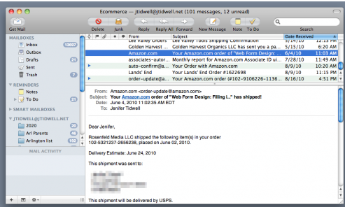
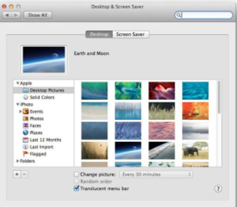
“Two Panel Selector”
A Two-Panel Selector has identical semantics to tabs: one area for the selectors, and one area next to it for the content of the selected thing.
Notes:
What
Put two side-by-side panels on the interface. In the first one, show a list of items that the user can select at will; in the second one, show the content of the selected item.
Use when
You have a list of items to show. Each item has interesting content associated with it, such as the text of an email message, a long article, a full-sized image, contained items (if the list is a set of categories or folders), or details about a file’s size or date.
You want the user to see the overall structure of the list and keep that list in view all the time, but you also want him to be able to browse through the items easily and quickly. People won’t need to see the details or content of more than one item at a time.
Physically, the display you’re working with is large enough to show two separate panels at once. Very small cell phone displays cannot cope with this pattern, but many larger mobile devices can.
Why
This is a learned convention, but it’s an extremely common and powerful one. People quickly learn that they’re supposed to select an item in one panel to see its contents in the other. They might learn it from their email clients, or from Windows Explorer, or from websites; whatever the case, they apply the concept to other applications that look similar.
When both panels are visible side by side, users can quickly shift their attention back and forth, looking now at the overall structure of the list (“How many more unread email messages do I have?”), and now at an object’s details (“What does this email say?”). This tight integration has several advantages over other physical structures as it reduces physical effort. The user’s eyes don’t have to travel a long distance between the panels, and he can change the selection with a single mouse click or key press rather than first navigating between windows or pages (which can take an extra mouse click).
It reduces visual cognitive load. When a window pops to the top, or when a page’s contents are completely changed the user suddenly has to pay more attention to what they are now looking at; when the window stays mostly stable, the user can focus on the smaller area that did change. There is no major “context switch” on the page.
It reduces the user’s memory burden. Think about the email example again: when the user is looking at just the text of an email message, there’s nothing on-screen to remind him of where that message is in the context of his inbox. If he wants to know, he has to remember, or navigate back to the list. But if the list is already on-screen, he merely has to look, not remember. The list thus serves as a “You are here” signpost.
How
Place the selectable list on the top or left panel, and the details panel below it or to its right. This takes advantage of the visual flow that most users who read left-to-right languages will expect (so try reversing it for right-to-left language readers).
When the user selects an item, immediately show its contents or details in the second panel. Selection should be done with a single click. But while you’re at it, give the user a way to change his selection from the keyboard, particularly with the arrow keys—this helps reduce both the physical effort and the time required for browsing, and contributes to keyboard-only usability.
Make the selected item visually obvious. Most GUI toolkits have a particular way of showing selection (e.g., reversing the foreground and background of the selected list item). If that doesn’t look good, or if you’re not using a GUI toolkit with this feature, try to make the selected item a different colour and brightness than the unselected ones—that helps it stand out.
What should the selectable list look like? It depends—on the inherent structure of the content, or perhaps on the task to be performed. For instance, most file system viewers show the directory hierarchy, since that’s how file systems are structured. Animation and video editing software use interactive timelines. A GUI builder may simply use the layout canvas itself; selected objects on it then show their properties in a property editor next to the canvas.
When the select-and-show concept is extended through multiple panels to facilitate navigation through a hierarchical information architecture, you get the Cascading Lists pattern.
Examples
Outlook

Slide 35
Stopping Points
Whenever the user is stopped from continuing down their course of action, that is a stopping point
Sometimes it is important to create a stopping point, but more often than not they are less desirable
Ensure not to stop the proceedings with unnecessary interruptions
Where appropriate, allow the user to permanently dismiss a dialogue so that the application does not ask the user that question in the future

Slide 36
Errors
All too often the process is halted by an error message
If that error message has no suggestions for a next course of action then the design is wrong
If there is nothing that the user can do, as a designer you should consider the existence of the error message to be a bug
Notification
Notification messages should never stop proceedings
If your product ever has a notification that merely requires the user to click on an “OK” button, but has no other options, then the design is faulty

Slide 37
Confirmations
“Are you sure you want to quit?”
“Do you want to leave this page?”
There are times when it is important to confirm a request, and that is when an irreversible and costly mistake is potentially being made
Never ask a user to make a potentially irreversible and costly decision in a confirmation dialogue; the information that they will need in order to make that decision almost certainly cannot be displayed in the dialogue, making it the wrong method for parsing the decision

Slide 38
Summary
The Structure phase gives us the building blocks for our physical design
  We need to develop navigation, tasks in a User-centered design (UCD) way
  We need to build in a consistent metaphor
  We need to build consistent notifications, errors, stopping points
  We need to build products users want to use
    That pleases them to use
    That may be because of need but its not an excuse for poor UCD

Slide 39
Recommended Books
Unger, R. and Chandler, C., 2012. A project guide to UX design. Berkeley, Calif: New Riders.
Garrett, J., 2011. The elements of user experience. Berkeley, CA: New Riders.
Spencer, Donna (2011-04-13). A Practical Guide to Information Architecture (Kindle Locations 2318-2322). Five Simple Steps. Kindle Edition.

